Slide 1

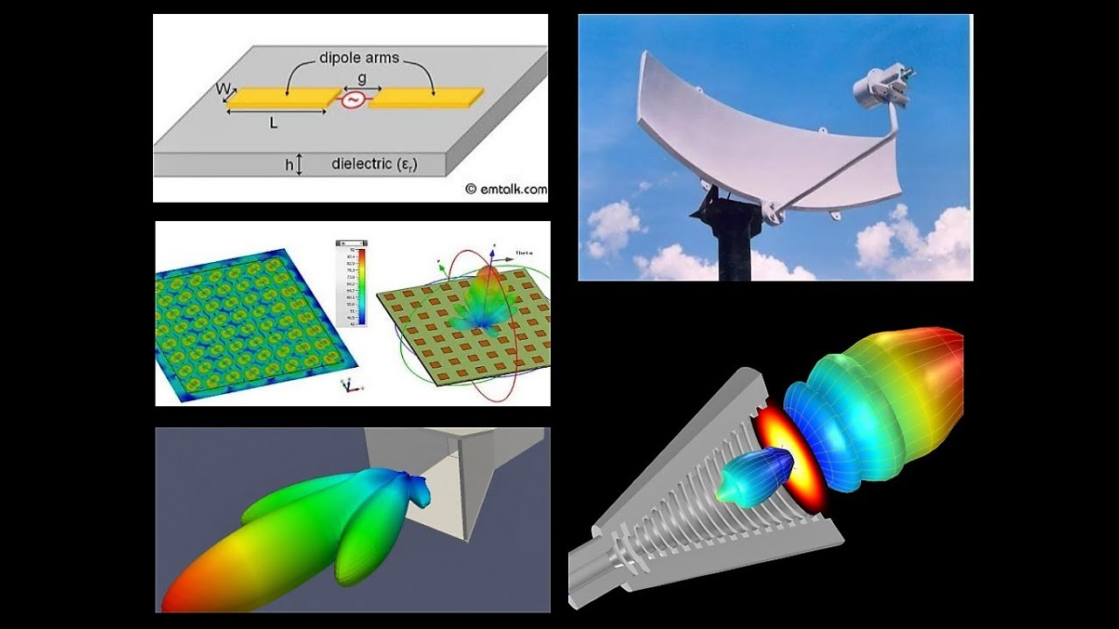
INSTITUTE OF ENGINEERING & MANAGEMENT
Microstrip Patch Antenna
Presented by
Guided by
PUJA SAHA
(22020002003032(195))
Prof. Srijita Chakraborty
Bachelor of Technology
in
Electronics and Communication Engineering
Electronics and Communication Engineering
2023

Slide 2
Content
Acknowledgement
Abstract
Introduction
Types of Patch Antenna
Circuit Diagram of Project
Feeding Methods
Experimentation
Results
Advantages and Disadvantages
Applications
Conclusion
Future scope
Microstrip Patch Antenna
2023
2

Slide 3
1. Acknowledgement
I would like to express my gratitude towards Prof. Srijita Chakraborty for guiding me throughout the project.Their willingness to give their time so generously has been very much appreciated.Also,I would like to extend gratitude to the author’s of the papers and information sources without this project wouldn’t have been possible.
Microstrip Patch Antenna
2023
3

Slide 4
2. Abstract
The performance and advantages of microstrip patch antennas such as low weight, low profile, and low cost made them the perfect choice for communication systems engineers. They have the capability to integrate with microwave circuits and therefore they are very well suited for applications such as cell devices, WLAN applications, navigation systems and many others In this thesis; a compact rectangular patch antennas are designed and tested for GPS devices at 1.57542 GHz, and for a satellite TV signal at 11.843 GHz and 11.919 GHz. The final part of this work has been concentrated on studying an array antenna with two and four elements. The antennas of the design examples of this work has been manufactured and tested in laboratory
Microstrip Patch Antenna
2023
4

Slide 5
3. Introduction
Antenna is a transducer designed to transmit or receive electromagnetic waves.
A signal from a transmission line or the guided device(hence the term guided wave) like to coaxial cabel is given to an antenna which then convert the signal into electronicmagnatic energy to be transmitted through space (hence the term free space)
Microstrip Patch Antenna
2023
5

Slide 6
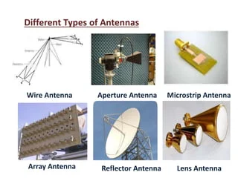
Microstrip Patch Antenna
2023
6

Slide 7
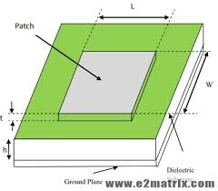
Microstrip Patch Antenna
A microstrip patch antenna (MPA) consists of a conducting patch of any planar or nonplanar geometry on one side of a dielectric substrate with a ground plane on other side.
Configuration:-
In the wide range of antenna models there are different structures of Microstrip antennas They are:
The patch.
Dielectric Substrate.
Ground Plane.
Feed Line.
Structure:-L-length of microstrip patch element
W-width of microstrip patch element
t-thickness of patch
h-height of dielectric substrate
Microstrip Patch Antenna
2023
7

Slide 8
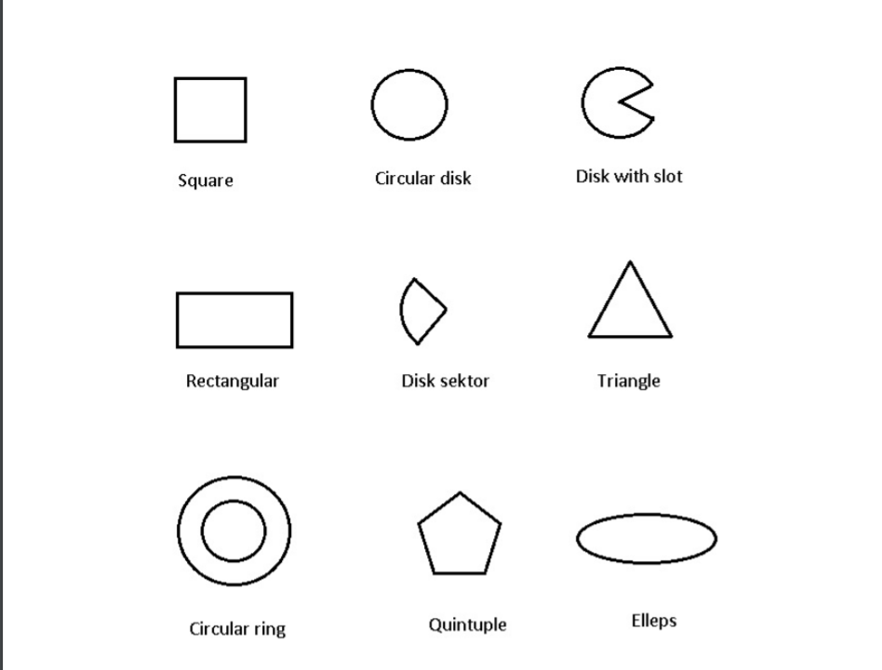
5. Types of Patch Antenna
There are a large number of shapes of microstrip patch antennas; they have been designed to match specific characteristics. Some of the common types are shown in figure for millimeter wave frequencies, the most common types are rectangular, square, and circular patches.
Microstrip Patch Antenna
2023
8

Slide 9
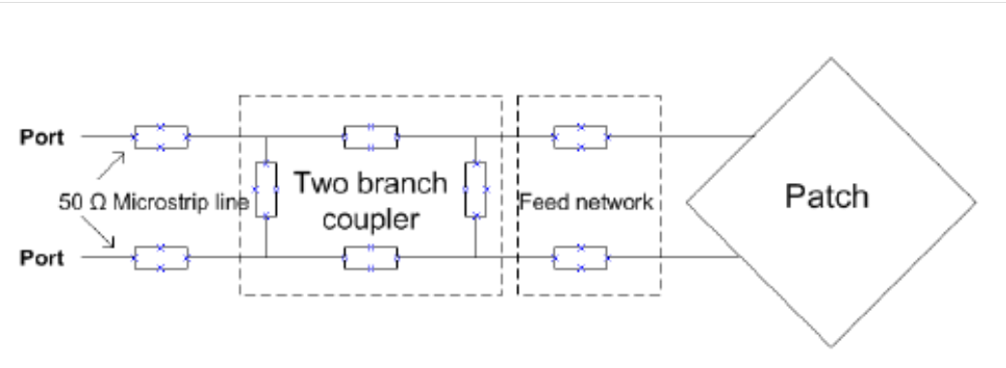
6. Circuit Diagram
Microstrip Patch Antenna
2023
9

Slide 10
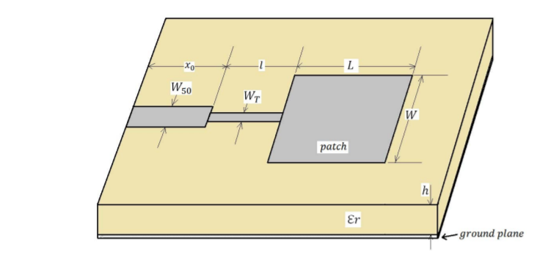
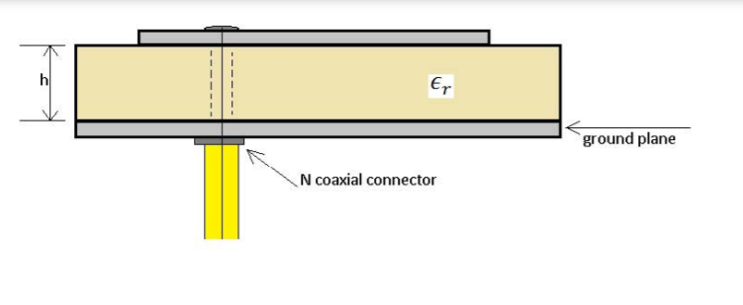
7. Feeding Methods
A feedline is used to excite to radiate by direct or indirect contact . There are many methods of feeding a microstrip antenna. The most popular methods:-
Microstrip Line.
Coaxial Probe (coplanar feed).
Microstrip Patch Antenna
2023
10

Slide 11
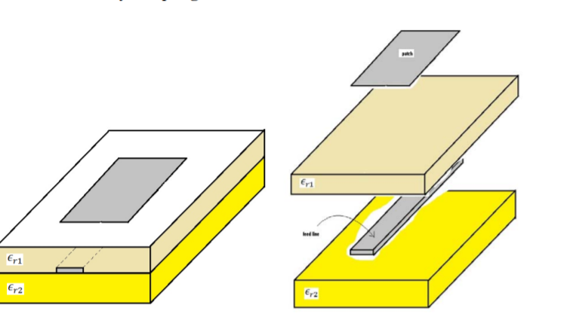
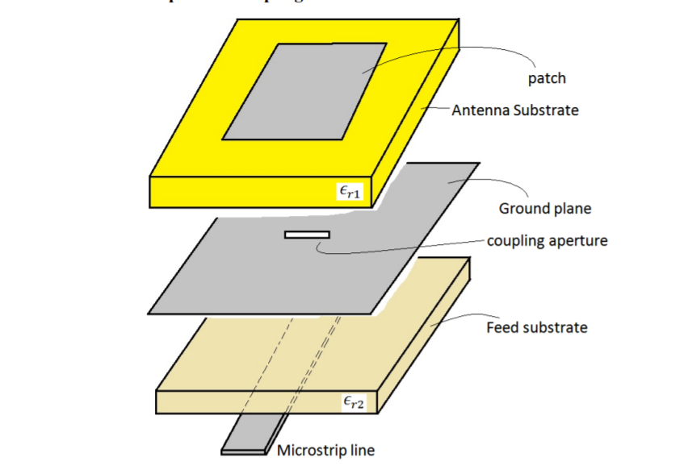
Proximity Coupling.
Aperture Coupling.

Slide 12
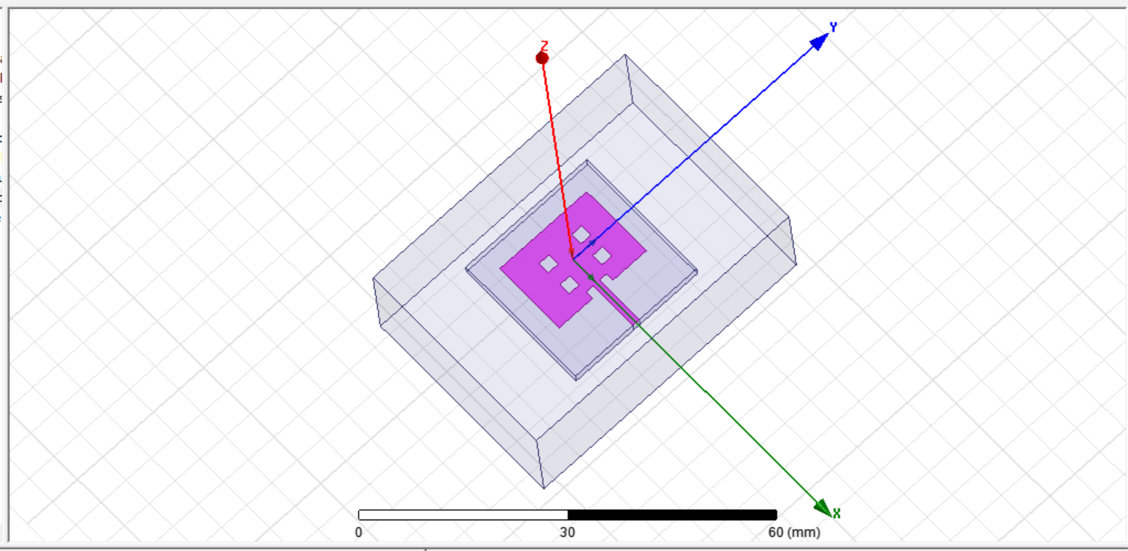
8.Experimentation(With Patch Antenna)
Microstrip Patch Antenna
2023
12

Slide 13
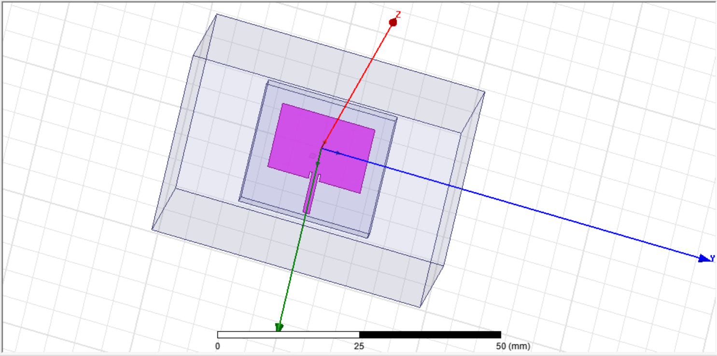
Experimentation(Without Patch Antenna)
Microstrip Patch Antenna
2023
13

Slide 14
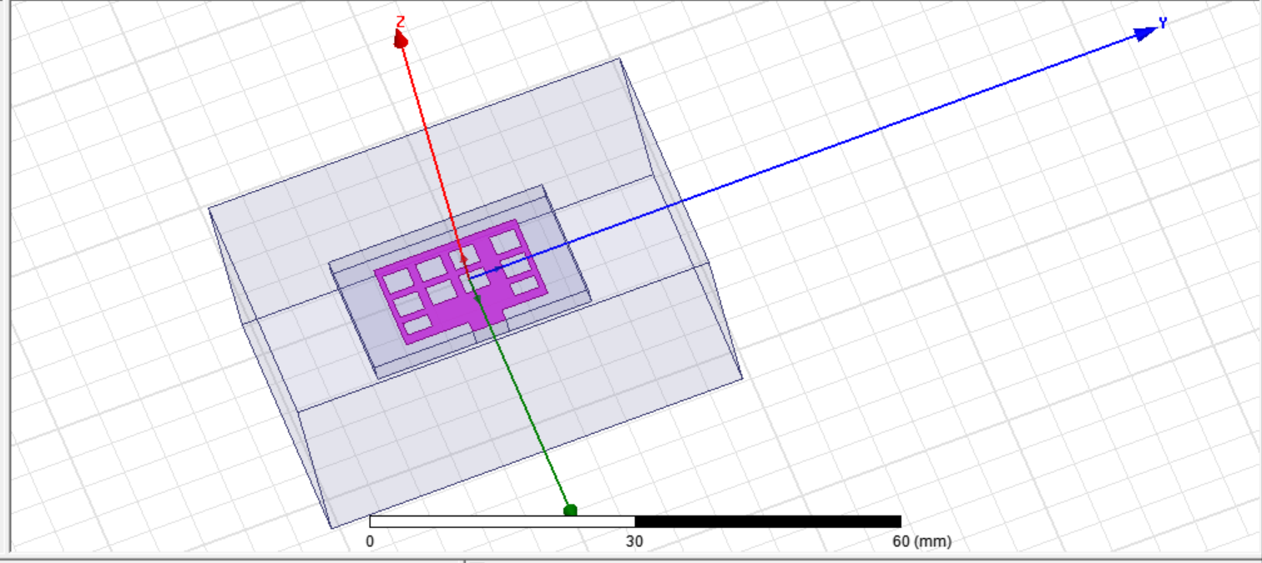
Experimentation(Multi-Patch Antenna)
Microstrip Patch Antenna
2023
14

Slide 15
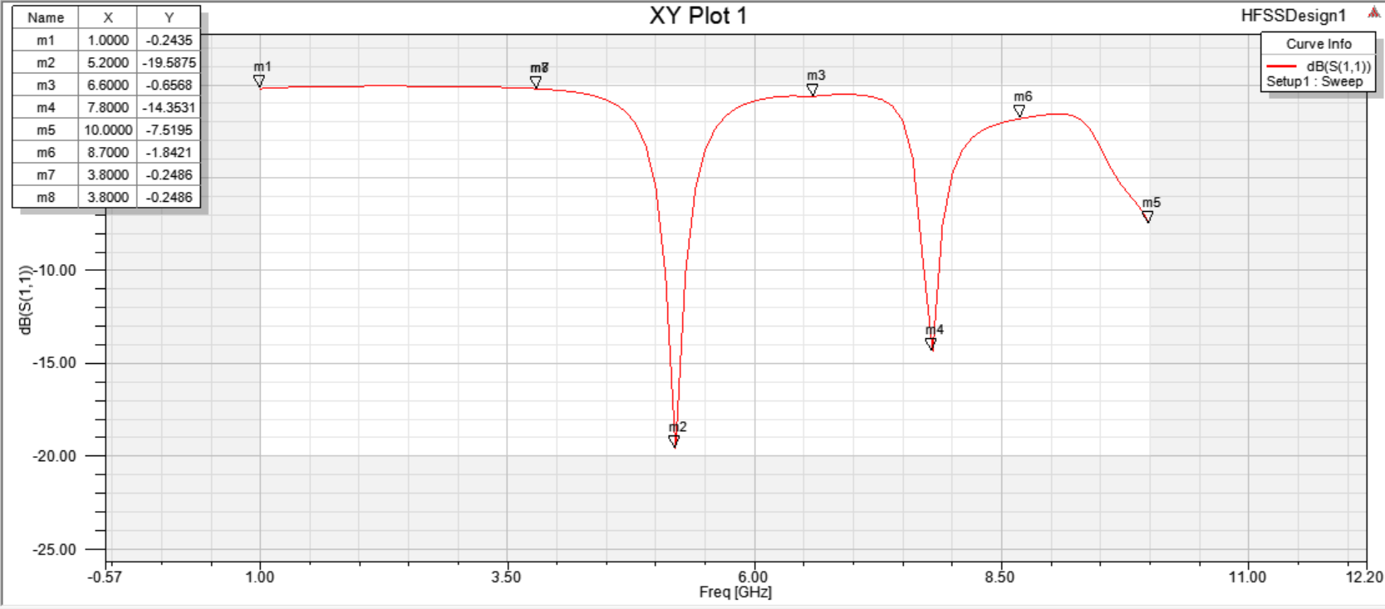
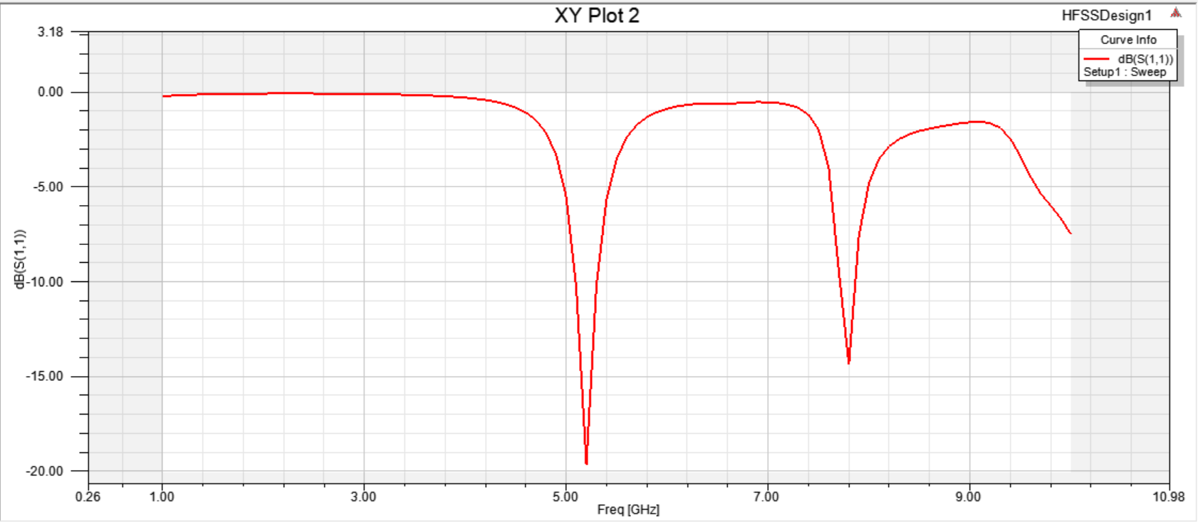
Results(With Patch Antenna)
S11 return loss
Bandwidth
Microstrip Patch Antenna
2023
15

Slide 16
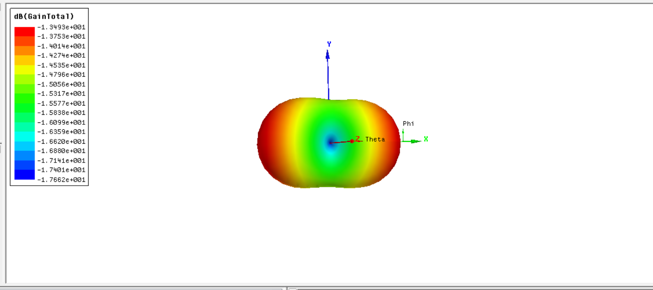
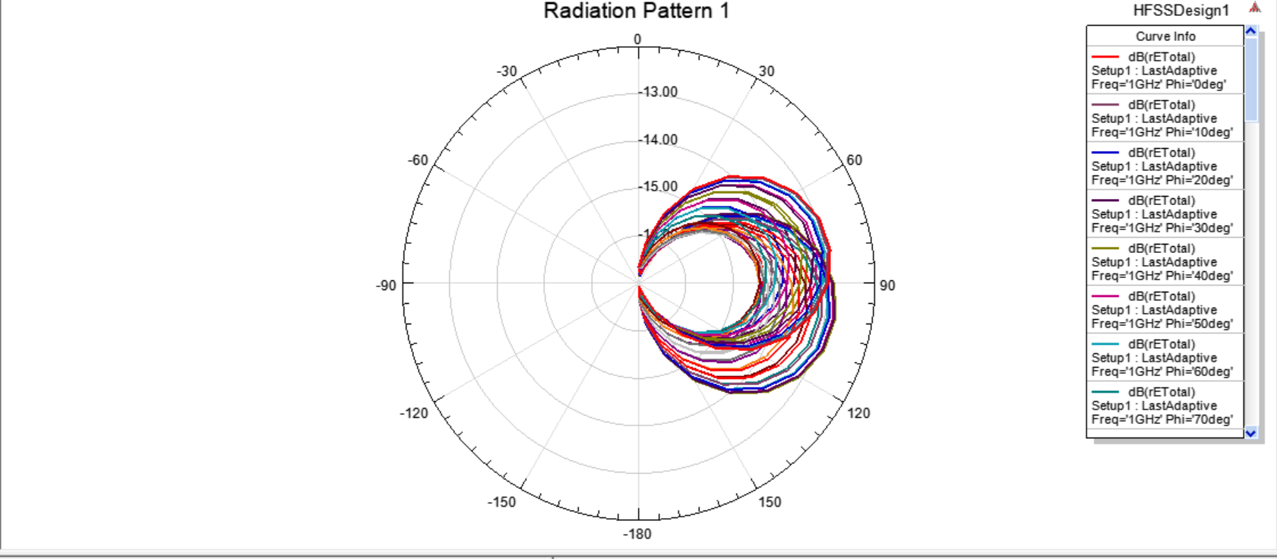
Gain
Radiation Pattern

Slide 17
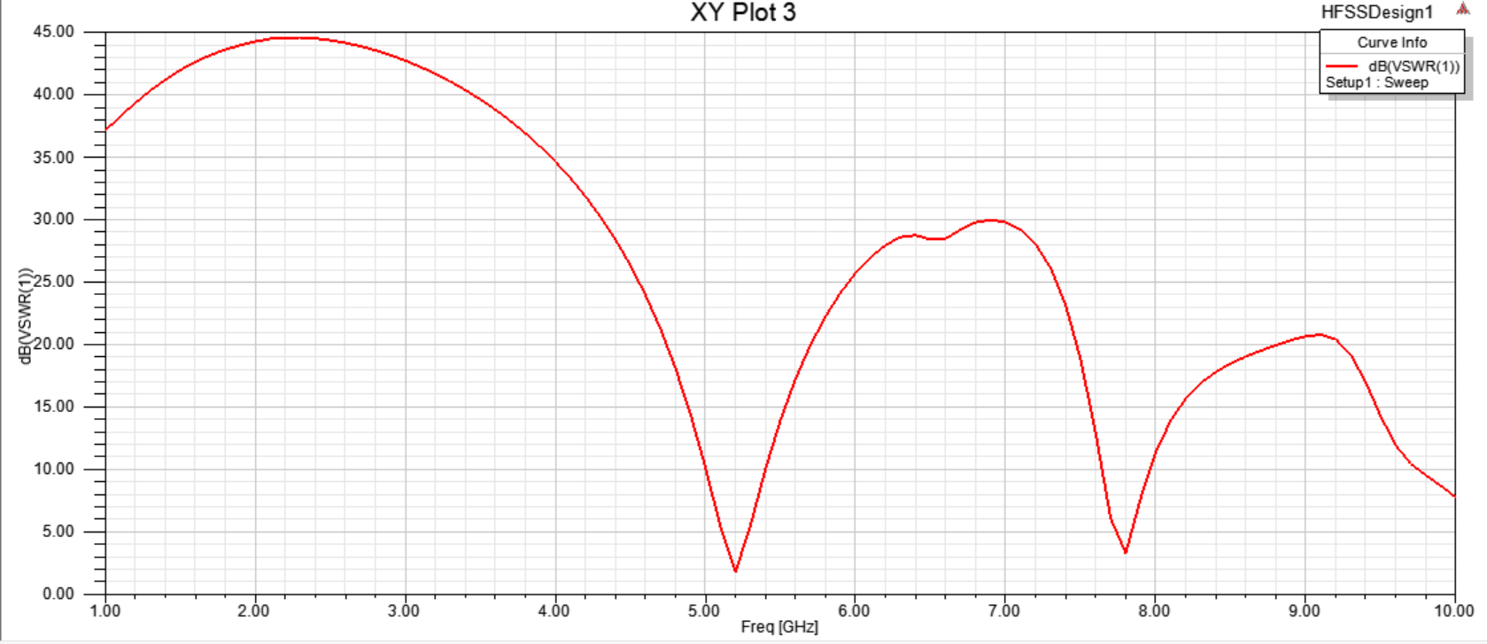
vswr

Slide 18
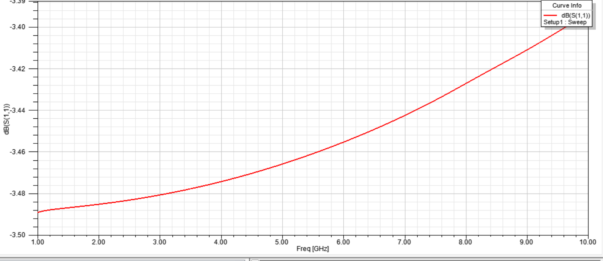
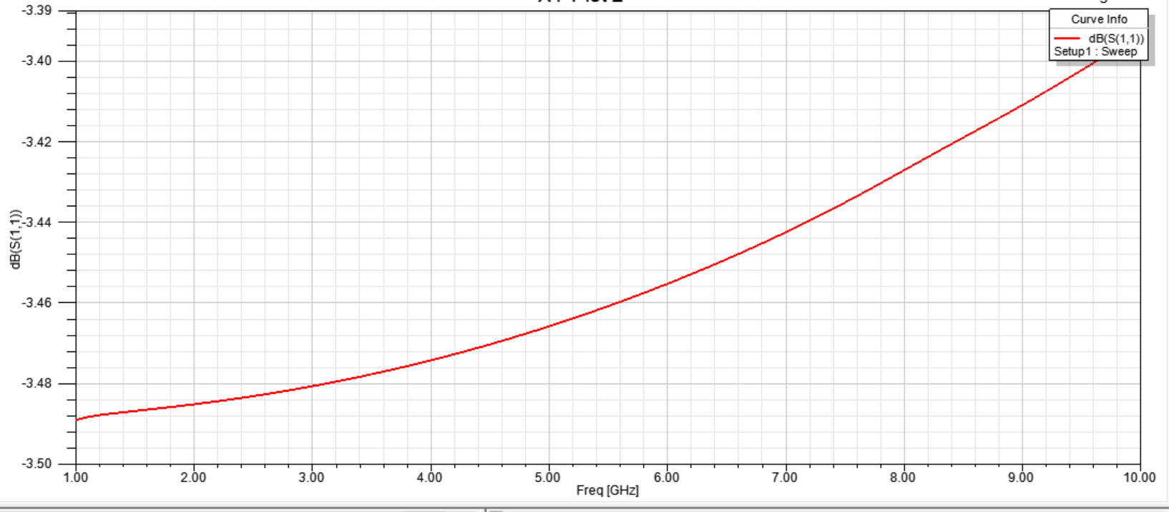
Results(Without Patch Antenna)
S11 return loss
Bandwidth
Microstrip Patch Antenna
2023
18

Slide 19
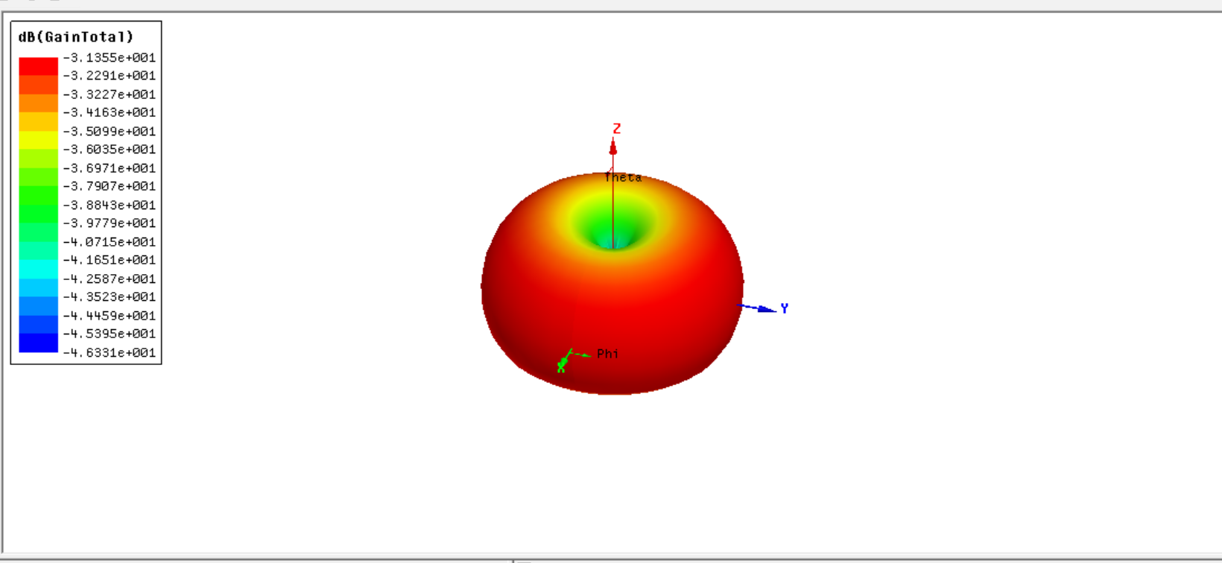
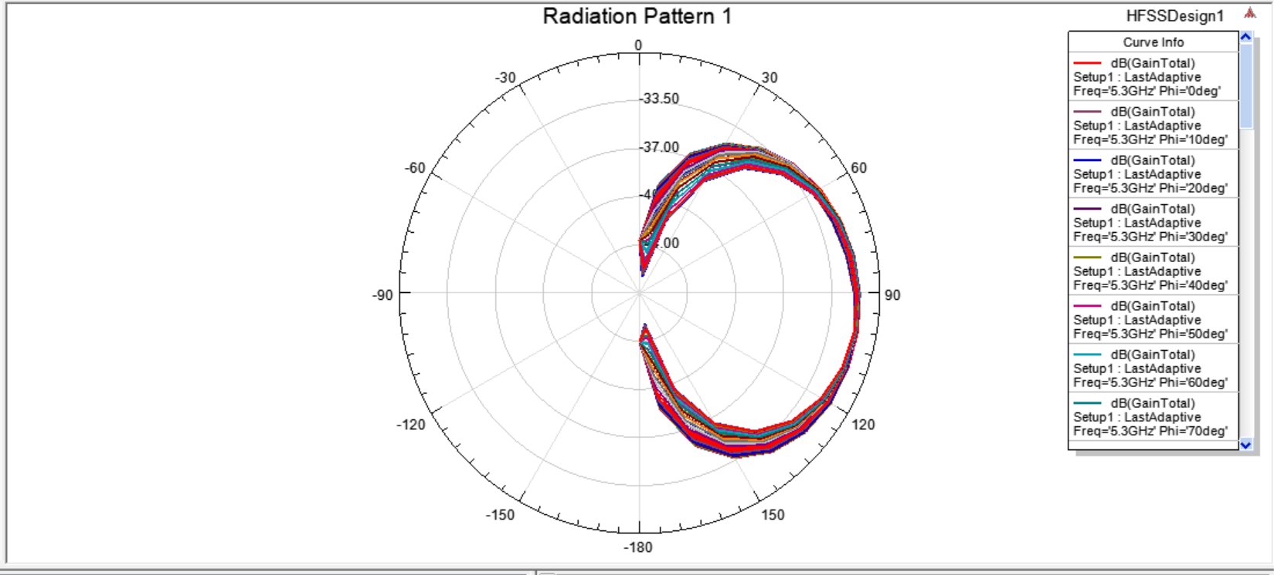
Gain
Radiation Pattern

Slide 20
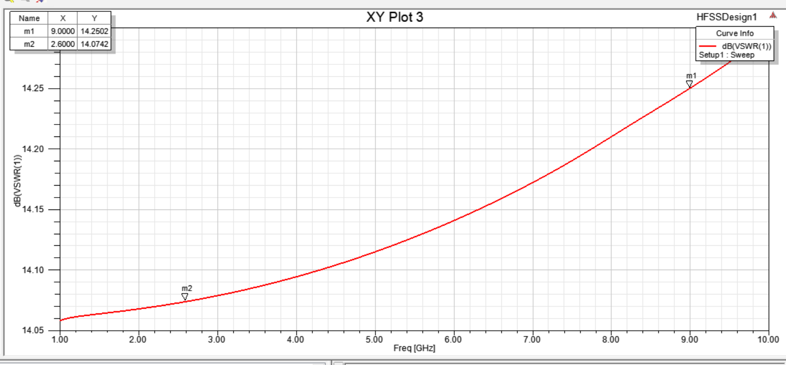
vswr

Slide 21
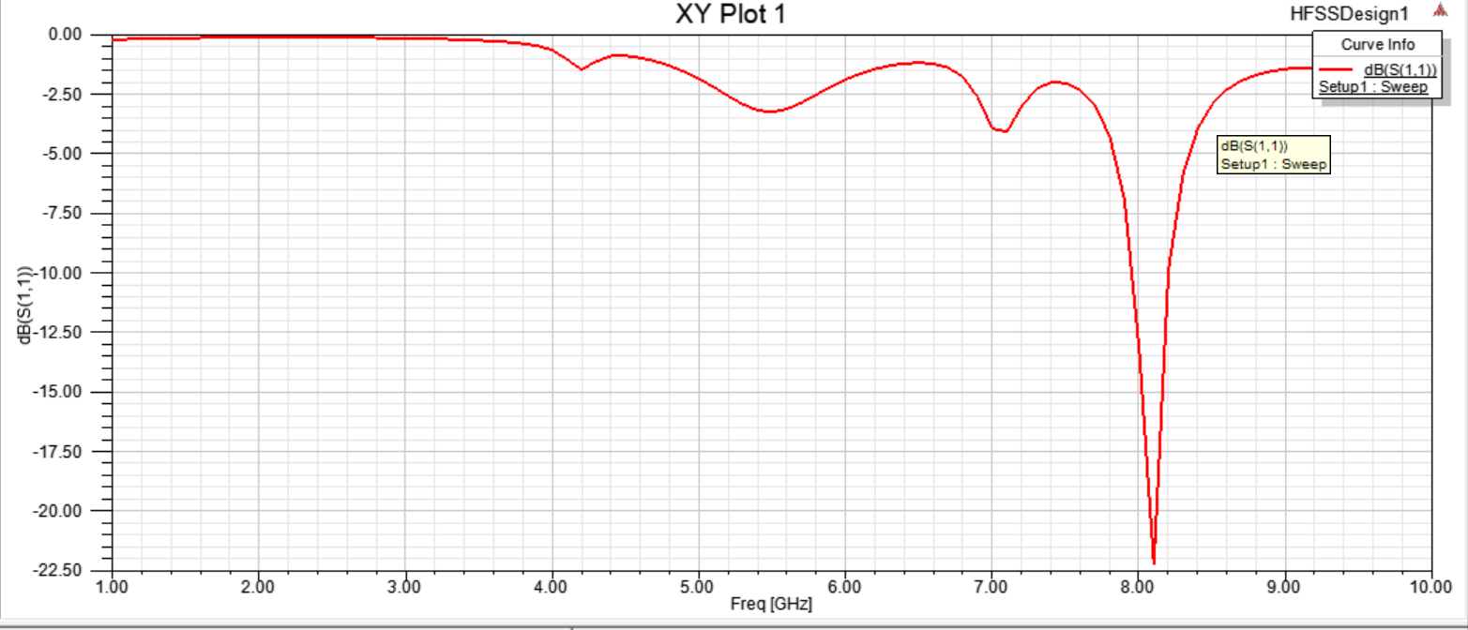
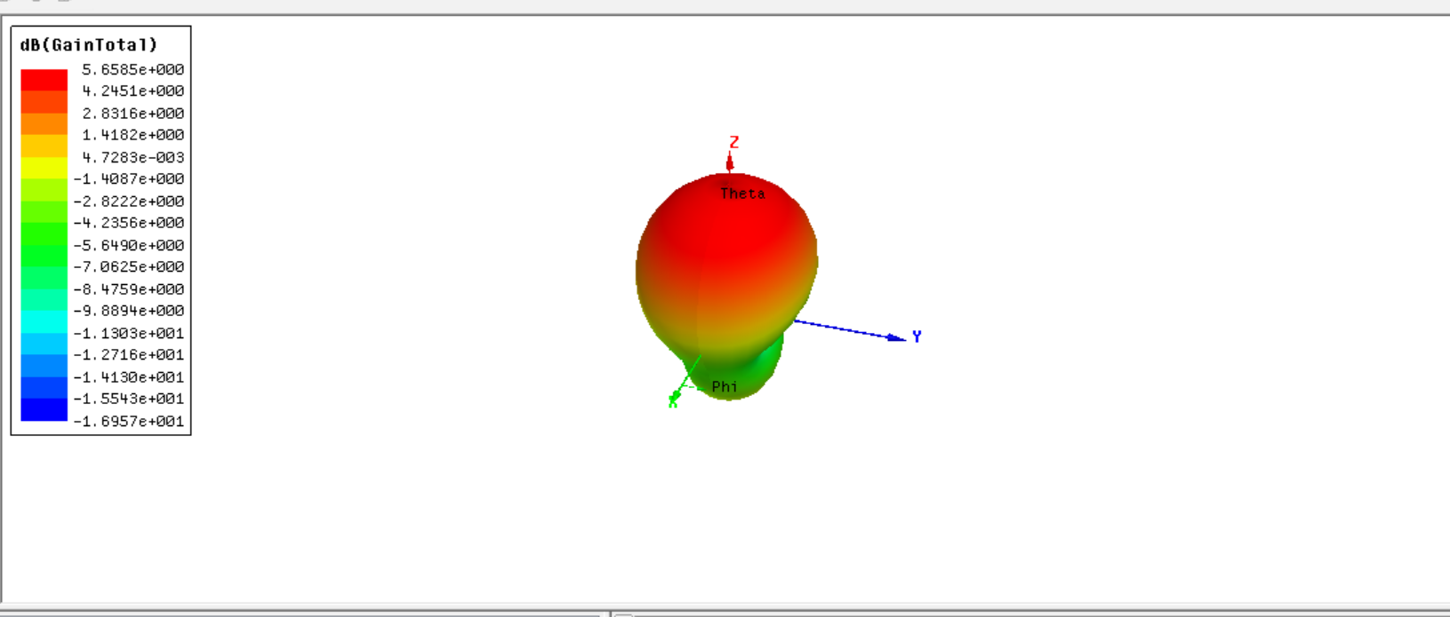
Results(Multi-Path Antenna)
S11 return loss
Gain
Microstrip Patch Antenna
2023
21

Slide 22
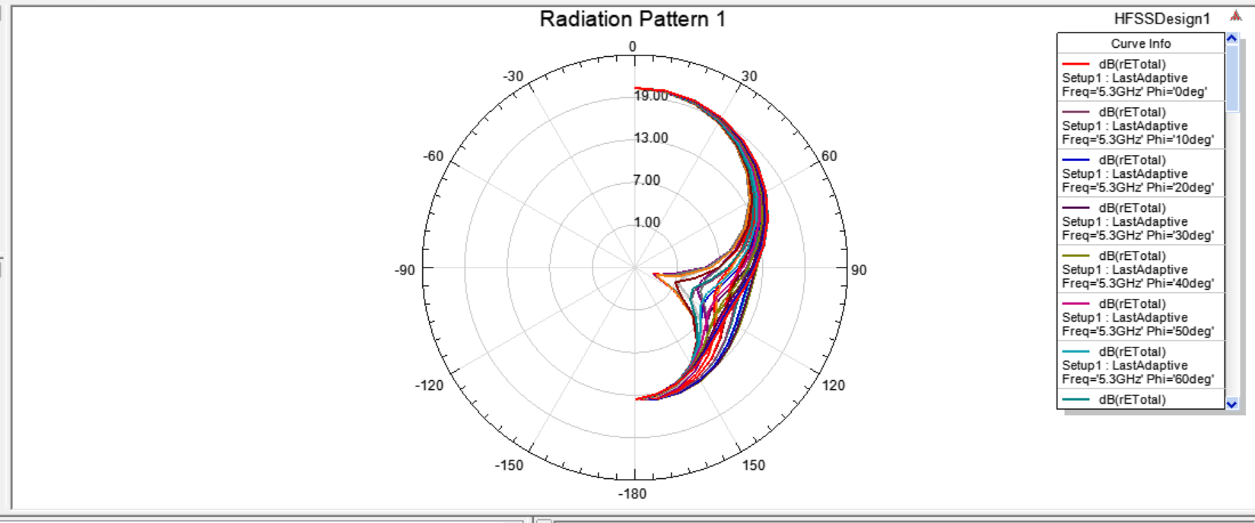
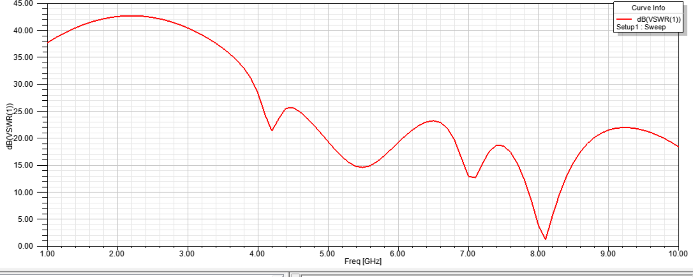
Radiation Pattern
diation Pattern
vswr

Slide 23
Advantage and Disadvantage
Advantage-
➨ They have lower fabrication cost and hence they can be mass manufactured. ➨They are capable of supporting multiple frequency bands (dual, triple). ➨They support dual polarization types viz. linear and circular both. ➨They are light in weight. ➨They are robust when mounted on rigid surfaces of the devices.
Disadvantage-
➨ It offers low efficiency due to dielectric losses and conductor losses. ➨It offers lower gain. ➨It has higher level of cross polarization radiation. ➨It has lower power handling capability. ➨It has inherently lower impedance bandwidth.
Microstrip Patch Antenna
2023
23

Slide 24

11. Applications
In global positioning satellite (GPS) systems, circularly polarised microstrip antennae are used. They are very compact in size and quite expensive due to their positioning. Microstrip antennae are also used in the fields of RFID (radio frequency identification), mobile communication and healthcare.
Microstrip Patch Antenna
2023
24

Slide 25
12. Conclusion
The microstrip patch antennas are most preferable antennas due to its inherent advantages like small size and weight, low cost, printed directly on the circuit board, low profile and easy to fabrication.
The rectangular patch antenna with 50 ohm coaxial feed has been designed.
The enhancement was large about 110 MHZ of bandwidth enlarge ,this means that the differences with a bit care of the design parameters.
Microstrip Patch Antenna
2023
25

Slide 26
13. Future scope
The rectangular patch antenna has been implemented and analyzed using IE3D. To improve the gain of rectangular patch antenna, probe feed has been used. Future work can be focused on the analysis and design of antennas for advanced technologies like, ultra-wideband and cognitive radio.
Microstrip Patch Antenna
2023
26

